Slide 1
Evaluating Route Changes Using High-Resolution Transit Data
TRAVIS GLICK (presenter) tglick@pdx.edu
Dr. MIGUEL FIGLIOZZI figliozzi@pdx.edu

Slide 2
Project Application
Quantify changes to a roadway
Inform future decisions
Determine the impact of road diets on transit
Traditionally excluded
Understudied
Examine effect of new Transit only bridge
Evaluate performance of transit
Another use for transit high-resolution data
Introduction Methodology Road Diet Tilikum Crossing Conclusions Questions
Notes:
So why do we care?
Analysis of roadway performance inform decisions by policy makers, transit agencies and these decisions influence travel speeds, reliability and costs to both the user and the agency.
As for road diets, which I will dive deeper into later, they have been well studied, but not by transit and not for transit, which has been excluded from many of those analysis.
What is the impact?
We know that buses have been used in the past to look at roadway segments, some of my own work did just that. Using buses as probes works, because they have been shown to experience the same delays as vehicles. However, the reverse is not always true. For example, buses stop at locations where cars to do not, (bus stops)
Finally, this study seeks to evaluate the performance of buses as they cross the Tilikum Crossing and see how reality compares with originally stated goals

Slide 3
Data Sources – Stop Level & Disturbance
High Resolution GPS Data
Stop Level
Data collected at the bus stops
Ons, Offs, Lift, Dwell, Door Operations, Door Open Time
Widespread implementation
Widely used to analyze routes, segments, and bus stops
Disturbance Data
Data collected when the wheels stop
Cost: Free… but…
Introduction Methodology Road Diet Tilikum Crossing Conclusions Questions
Notes:
The first source of the data is High-resolution GPS data collected onboard buses. Every five seconds, a GPS coordinate and a timestamp are recorded on every bus in TriMet’s network.
The second of the data sources is stop level data. This type of data is widespread across transit agencies and has been used for years to analyze the operations of transit routes and bus stops.
Stop level data comes with a built in flaw. It is limited to activities at a bus stop or the average metrics of actions between them like speed. While is would be possible to determine that a problem occurred between stop A and stop B. the specific location of the problem is structurally difficult to determine.
Disturbance data, which is less widespread, but available from TriMet collects data each and every time the wheels of the bus stop moving. This event can occur at crosswalks, bus stops, intersections, or just from congestion. It tells you if the stop was planned or not, but not much else.
This information can help determine what is happening between bus stops, but can’t distinguish between segments where speeds fluctuate but average 15 miles per hour and segments that are actual 15 miles per hour (if the wheels don’t stop).
These data sources are free and can be requested using a Freedom of Information Act request or by sending a polite email to TriMet.
I should add that the data requires a great deal of cleaning and cost is hard to quantify. The data changes over time and codes must be regularly updated.
For example, the data structure changed from the before and after studies. They include deadheads and route deviations. Using HR data seems easy in theory, but there are many complications in practice.

Slide 4
The Process
25ft segments along each study area
Speeds extracted for each segment
before and after case
Compiled by:
Percentile
Time of Day
Introduction Methodology Road Diet Tilikum Crossing Conclusions Questions
Notes:
For the purposes of this presentation, I will describe just one case scenario that accurately explains the process.
A segment of a route is identified as the area that should be examined. That study area may be about a mile long.
It is then divided into 25 ft. segments. Each segment has known coordinates, a center point.
Data is then extracted from the entire set of buses, such that each bus provides its speed as it crosses each center point.
Each segment now has a list of speeds that define it and these speeds can be processed for percentiles or moving averages by time of day (as was done here)

Slide 5
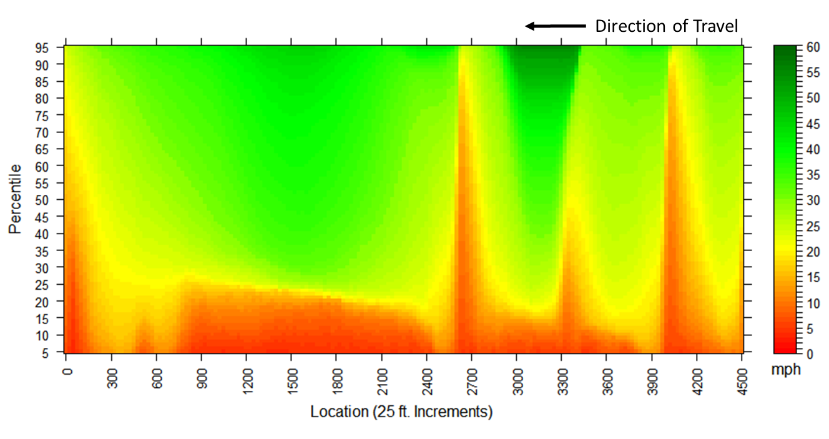
Percentiles
Introduction Methodology Road Diet Tilikum Crossing Conclusions Questions
Notes:
These speeds can be processed for percentiles as shown here.
The y axis is percentiles and the x axis is location (this is the results for our third study area (Powell Blvd)
The spikes at 2700, 3300, and 4000 are all bus stops.
There are no bus stops between 0 and 2700. It is one of the longest stretches of this Route without a stop.
[click]
The red you see below the 25th percentile in this area is not caused by bus stops or intersections, as there are neither. It is general congestion.

Slide 6
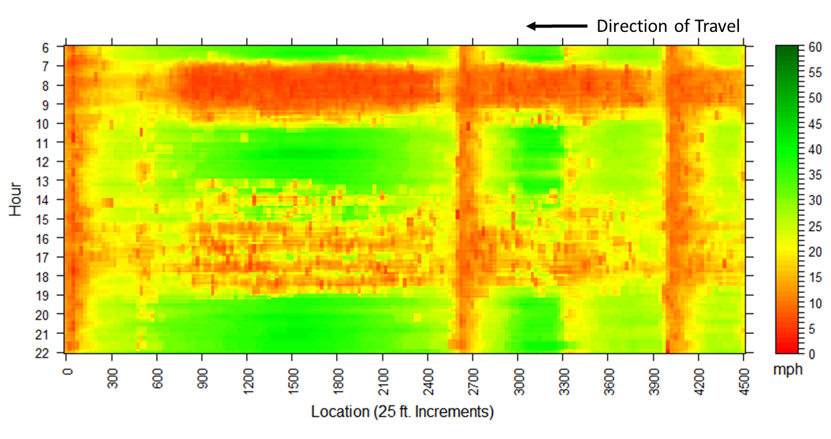
Time of Day
Introduction Methodology Road Diet Tilikum Crossing Conclusions Questions
Notes:
The same set of speeds can be analyzed for time of day using moving averages.
In this case, the significant congestion in the morning and more spread out congestion in the evening become apparent.
[click]
It’s in the same spatial area as the before.

Slide 7
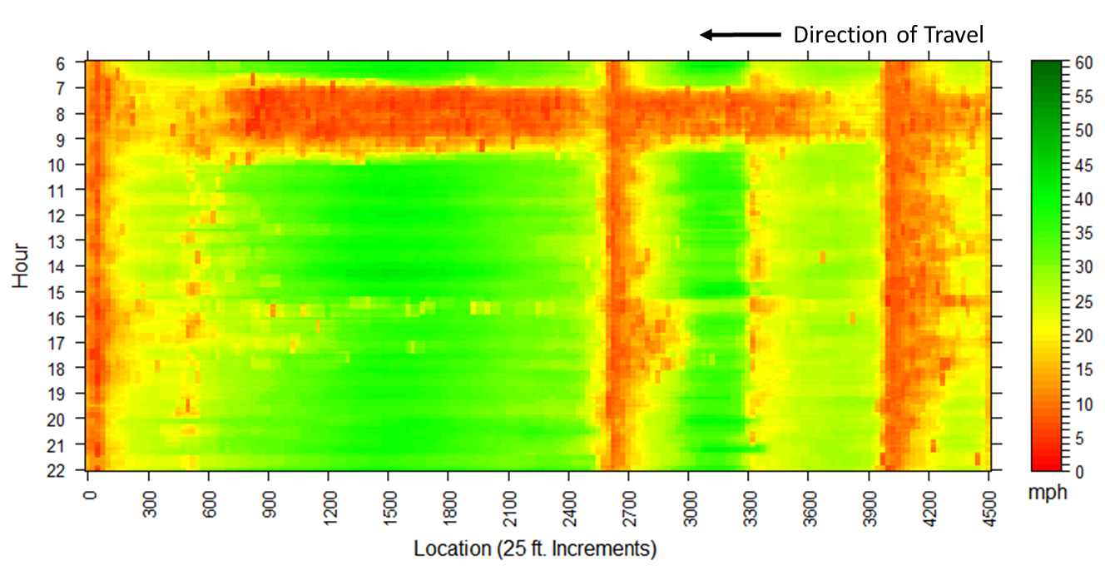
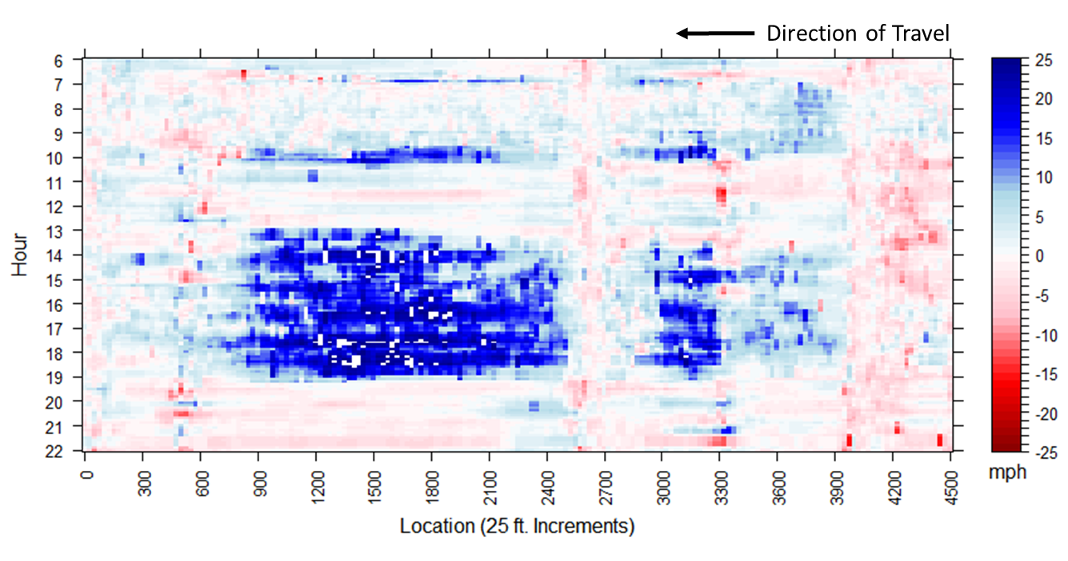
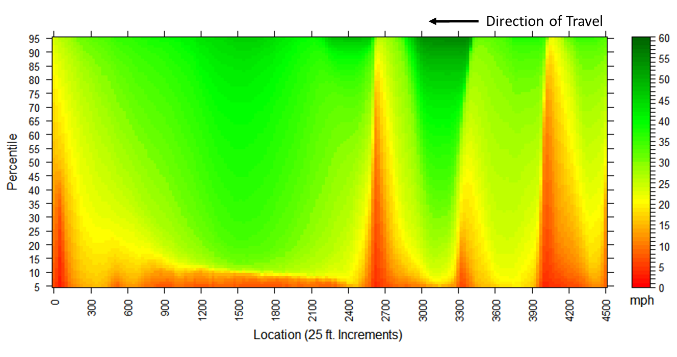
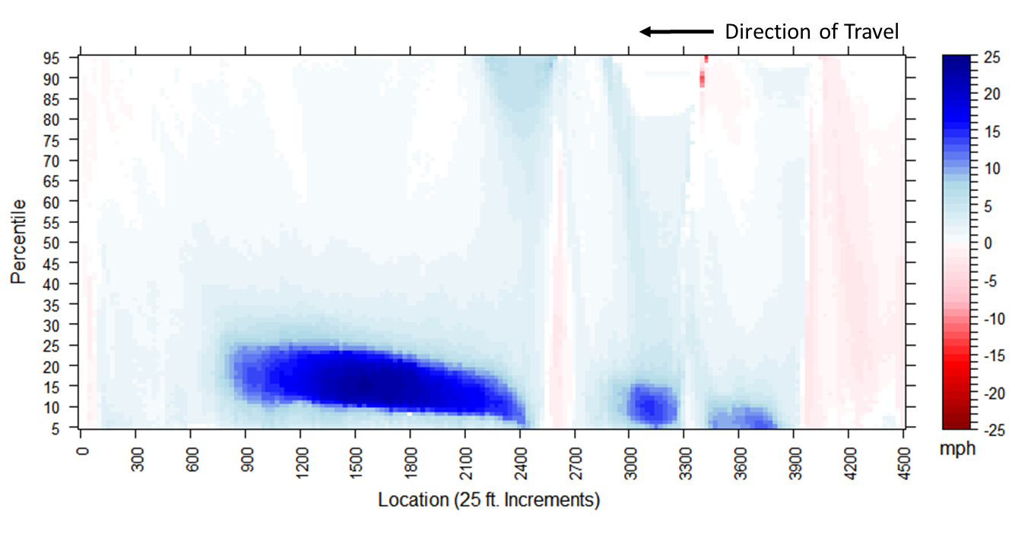
After minus Before equals Difference
_
=
_
=
Introduction Methodology Road Diet Tilikum Crossing Conclusions Questions
Notes:
For either percentiles or time of day, a before case is examined and an after case using temporally separated data.
Individually, a before case and an after case can give useful information. Compared, they give even more.
The before case is then subtracted from the after case to determine change, which are the shown in the graphs on the right.
The blue areas show places where speeds increased, the red where speeds decreased.
Again, I’ll provide details about those results later.

Slide 8
Road Diets
Reduce the width or number of travel lanes to add:
Bike lanes
Bike buffers
Transit lanes
Center turn lanes
Reduce travel speeds
Increase safety
Introduction Methodology Road Diet Tilikum Crossing Conclusions Questions
Notes:
First, lets talk about road diets
These are really useful to transit agencies. In many justifications they can be completed without the regular bureaucratic process.
Line restriping does not require any other repair work to the road. Traditionally, repair work triggers physical improvements evaluations, such as ADA compliance.
As such, the ability to make improvements without the evaluations is a useful tool.
Road diets usual reduce the number of lanes, thickness of lanes, or remove parking spaces to make way for other features.
One of the most common types is a four lane to three lane change that takes four travel lanes, and turns it into one vehicle lane in each direction one bike lane in each direction and a center left turn lane.
The effect of road dies has been studied and determined to reduce travel speeds and increase safety. But transit has not typically been a part of those studies.

Slide 9
Study Area: 16th Street
After
Before
Before
Introduction Methodology Road Diet Tilikum Crossing Conclusions Questions
Notes:
For the first test case, the segment analyzed covered 1500 ft.
900 feet of that segment was a road diet.
I’d like to draw your attention to the new bus stop. This location is important later.
[click]
The before case has two travel lanes in each direction with bike lanes.
[click]
A streeview shot here
[click]
After, notice the addition of a buffer on the side of a wider bike lane with only one travel lane.

Slide 10
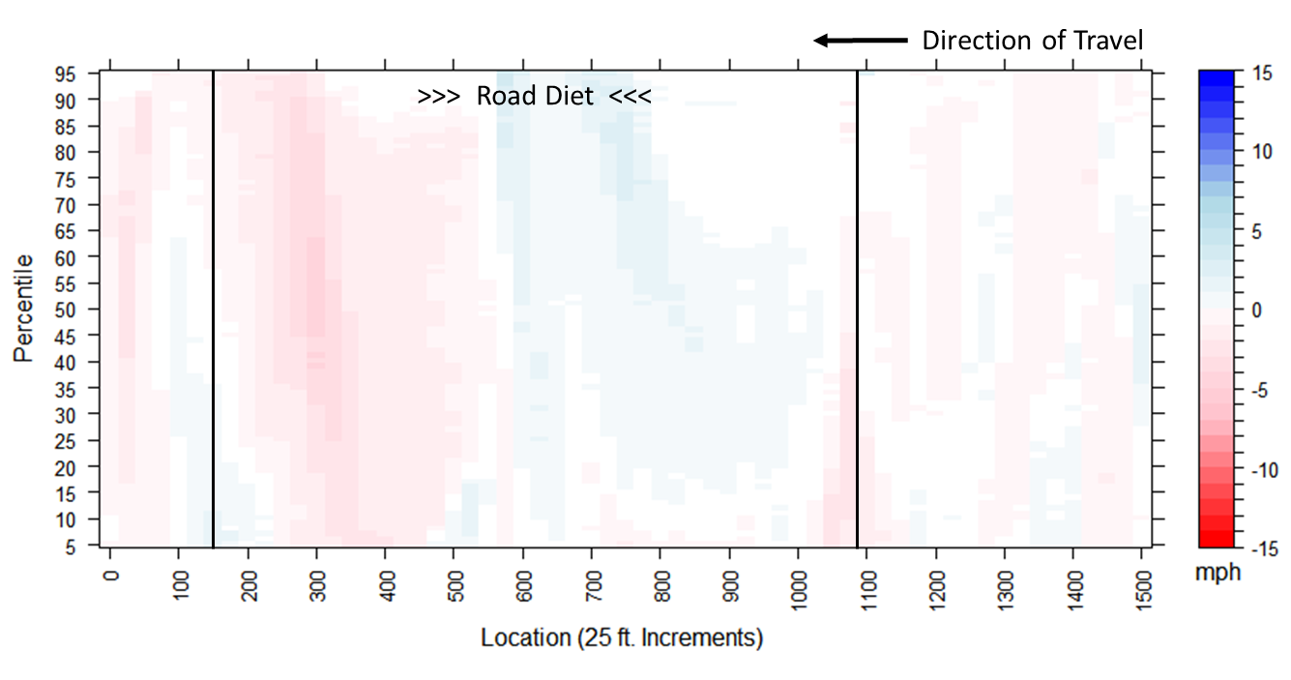
Study Area: 16th Street
Introduction Methodology Road Diet Tilikum Crossing Conclusions Questions
Notes:
In the direction with no added bus stop, the speeds remain near to their original values. No notable change in speeds.

Slide 11
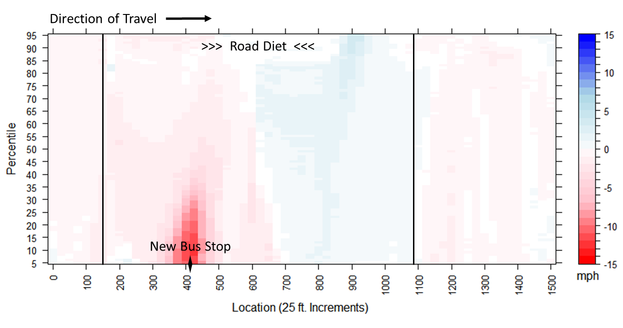
Study Area: 16th Street
Introduction Methodology Road Diet Tilikum Crossing Conclusions Questions
Notes:
After, the bus stop appears. Since the data used to create these plots does not include times where the bus is actually stopped,
this represents the slowdown experienced by both buses and personal vehicles.

Slide 12
Road Diets
Do road diets increase congestion for buses?
No.
Neither does it decrease congestion
Added stops will slow down regular traffic
Introduction Methodology Road Diet Tilikum Crossing Conclusions Questions
Notes:
The question at hand: Do road diets increase congestion?
Based on this test case and others not included here. The short answer is no.
The long answer is not by much. It doesn’t increase congestion, neither does it decrease congestion.
If you add a feature that will slow down buses (like a stop) general traffic is likely to feel that effect.

Slide 13
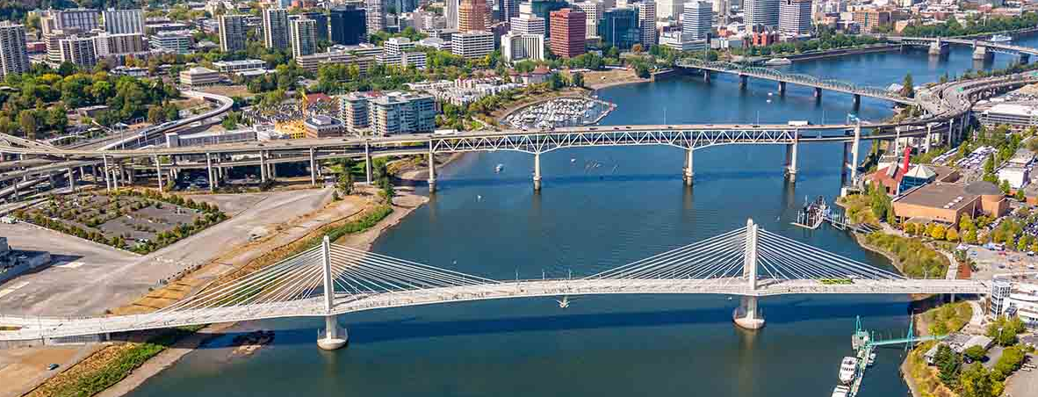
Study Area: Tilikum Crossing
Largest Vehicle Free bridge in the United States
Carries:
Light Rail
Buses
Street Car
Bikes
Pedestrians
http://www.hntb.com/HNTB/media/HNTBMediaLibrary/Expertise/Tilikum_Crossing_042web_1.jpg?ext=.jpg
Introduction Methodology Road Diet Tilikum Crossing Conclusions Questions
Notes:
The Tilikum crossing is the largest bridge in the united states that does not carry personal vehicles.
It is dedicated to transit, specific the max, street car, and buses, as well as wide bike and pedestrian travel lanes.
[click]
First, we will look at the approach to the changed route. This part of Route 9 experienced only a repainting of existing lines.
The type of markings did not change.

Slide 14
Study Area: Eastside of Bridge
Introduction Methodology Road Diet Tilikum Crossing Conclusions Questions
Notes:
Moving towards the city center, travel speeds increased during the congested parts of the day when you compare averages from before and after.
According to this type of graphic, we can see that about 15 percent of vehicles saw a increase in travel speeds.

Slide 15
Study Area: Eastside of Bridge
Introduction Methodology Road Diet Tilikum Crossing Conclusions Questions
Notes:
By time of day
[click]
It is clear that the morning commute remained largely unaffected
[click]
In contrast, the evening commute into the city center experienced a notable increase in travel speeds.
Again, this is the location without bus stops or intersections.

Slide 16
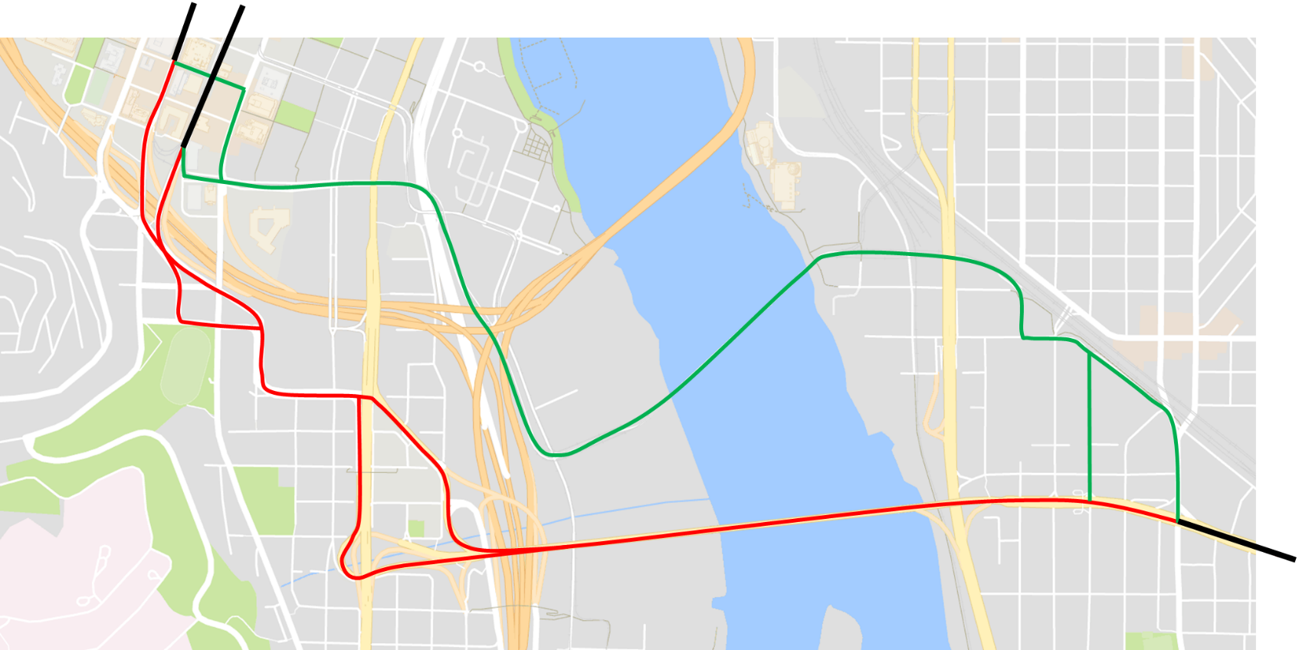
Study Area: Tilikum Crossing
Before
After
After:
Eastbound = 2.0 miles
Westbound = 2.2 miles
Tilikum Crossing
Before:
Eastbound = 2.0 miles
Westbound = 2.0 miles
Ross Island Bridge
Introduction Methodology Road Diet Tilikum Crossing Conclusions Questions
Notes:
This is the segment we were examining before, It is on the east side of the river.
[click]
The route changed as shown here. We will examine travel times over this changed segment.

Slide 17
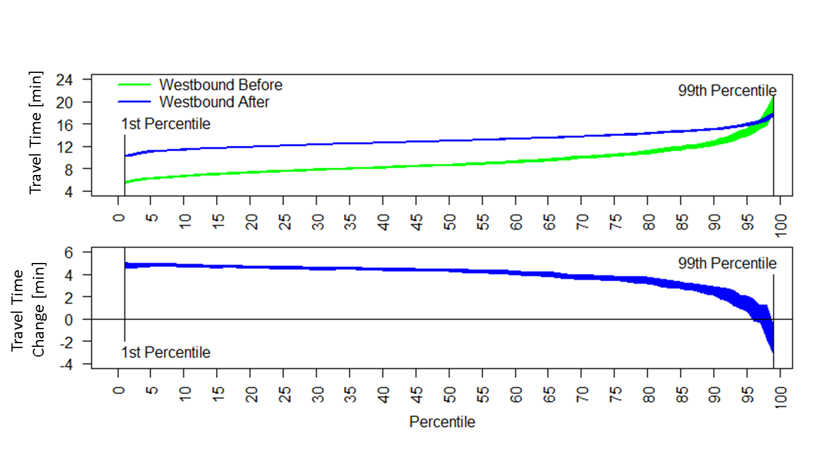
Travel Time Percentiles: Inbound to City Center – All Day
Introduction Methodology Road Diet Tilikum Crossing Conclusions Questions
Notes:
For trips inbound to Portland City center, most the trips experienced an increased travel time. Except for the very slowest trips.
While slower trips is not usually considered ideal, the improved regularity of travel times is a notable improvement for planning purposes.

Slide 18
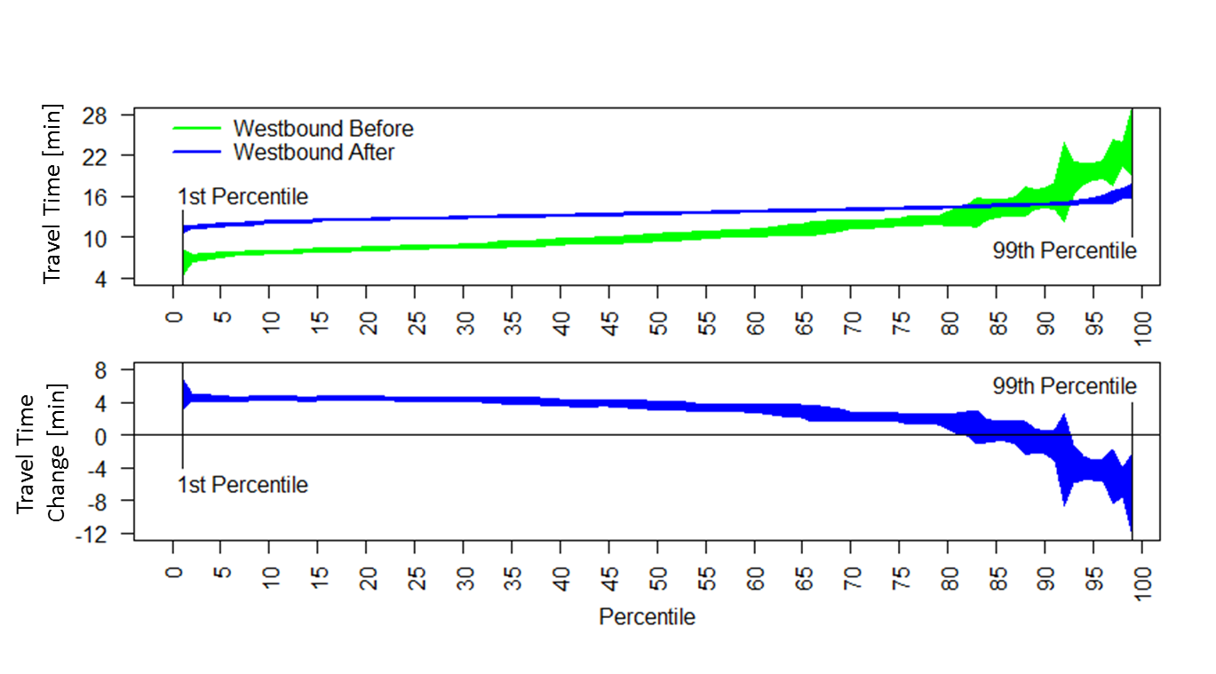
Travel Time Percentiles: Inbound to City Center – AM Peak
Introduction Methodology Road Diet Tilikum Crossing Conclusions Questions
Notes:
For example, the AM peak previously saw trips ranging from 6 minutes to mid 20s.
After, they range from about 12 to 16. Even those this is generally slower, this is much easier to keep buses on time and to avoided bunching.

Slide 19
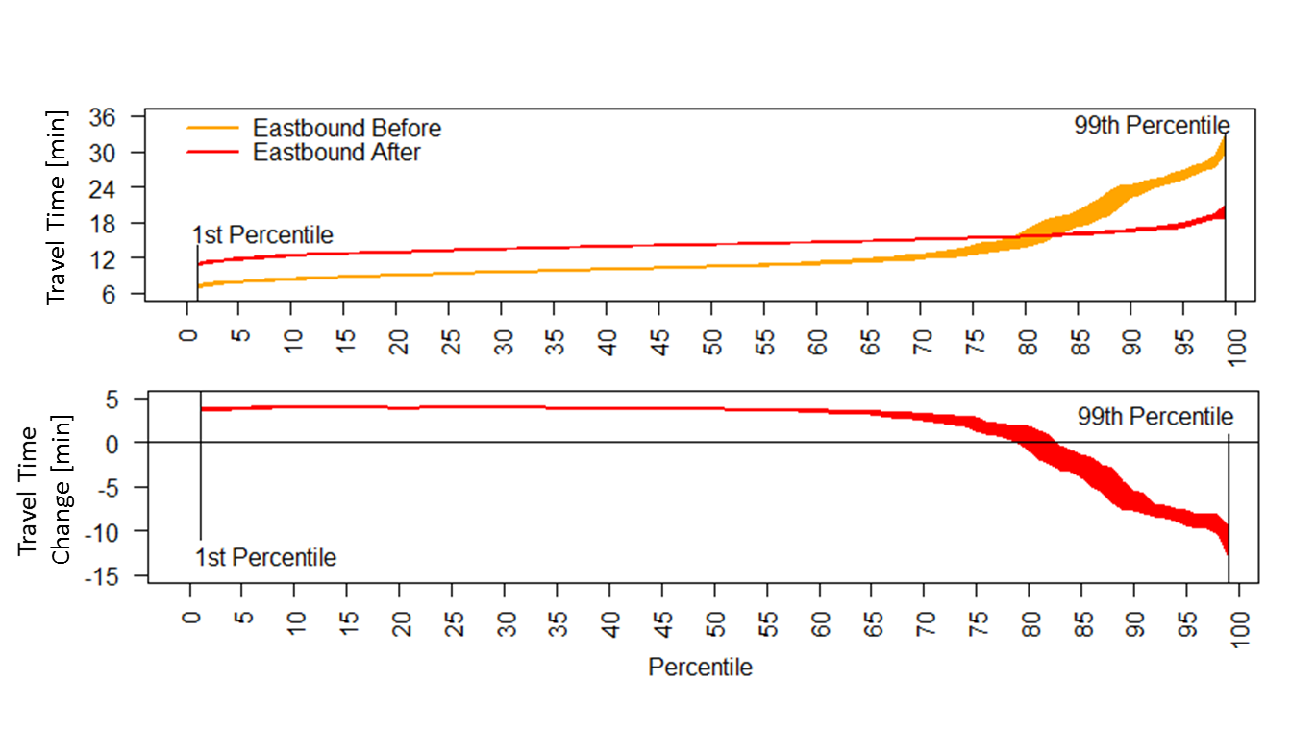
Travel Time Percentiles: Outbound from City Center – All Day
Introduction Methodology Road Diet Tilikum Crossing Conclusions Questions
Notes:
Outbound from the city center, more trips experienced an improved travel time, but the majority still experienced increased travel times.
Again, the variation between the best and worst trip times is notably improved.

Slide 20
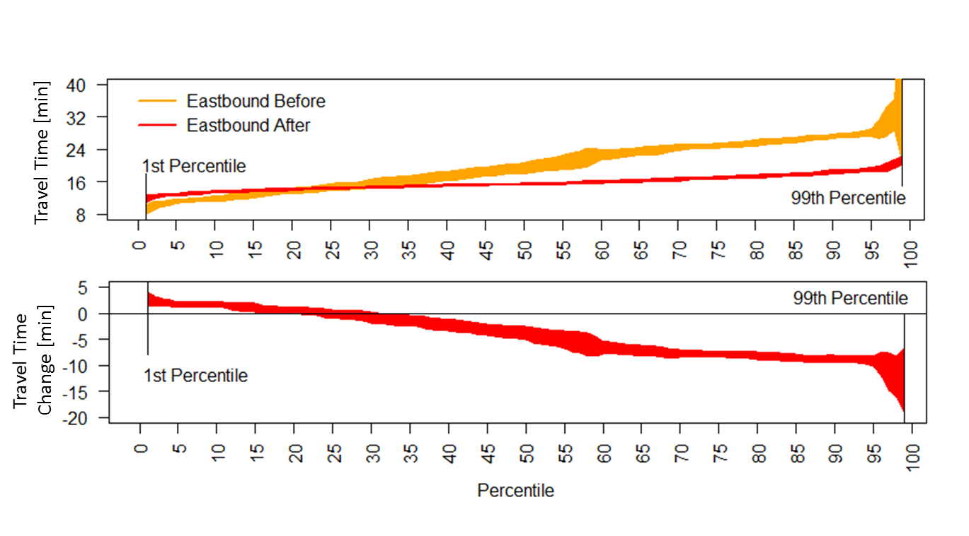
Travel Time Percentiles: Outbound from City Center – PM Peak
Introduction Methodology Road Diet Tilikum Crossing Conclusions Questions
Notes:
During the PM peak outbound from the city center, we get a different story.
The vast majority of trips saw and improved trip time an experienced benefits of consistency.

Slide 21
Study Area: Tilikum Crossing
Travel Time Increased
Range of travel times in peak period was reduced
Increase on-time performance
Assist with operational planning
This can save TriMet money
Introduction Methodology Road Diet Tilikum Crossing Conclusions Questions
Notes:
Overall travel times did appear to increase as a result of the new bridge.
The variability of travel times in the peak periods were reduced which will make it easier for TriMet to make schedules.
They may have less need of added buses during these times which will save money.

Slide 22
Conclusions
The methodologies can quantify roadway changes
Apply methodologies in new ways
Provide insights into how a change impacted transit and vehicles
Show how travel time reliability changes
Road diets are unlikely to increase congestion
Introduction Methodology Road Diet Tilikum Crossing Conclusions Questions
Notes:
Overall, these methodologies can quantify the effects caused by changes to roadways using a new application of high resolution data.
Buses may be used as probe vehicles to examine the behavior of general traffic
And can show not only changes in speeds, but also changes in speed variability.
While not the purpose of this study, which aimed to show a methodology, I personally approve of the new bridge and think road diets are a good idea.

Slide 23
Thank you for Listening. Any Questions?
TRAVIS B. GLICK (presenter) tglick@pdx.edu
Dr. MIGUEL A. FIGLIOZZI figliozzi@pdx.edu
Introduction Methodology Road Diet Tilikum Crossing Conclusions Questions
Notes:
Thank you
Any Questions?

